Slide 1
CPS 109 - Lab 2

Slide 2
Agenda
- Housekeeping (will likely bypass)
- Recap of Last Week
- Operators
- Lists
- Loops

Slide 3
Reminders:
Your | default | username: | Your my.ryerson | Short | ID
Your | default | password: | MMDDXXXX (birth | month,
birth day, last 4 digits of your student #)
Our Contact Information: Gurpreet: gurpreetkaur.kaur@torontomu.ca
Mojan: mnooshin@torontomu.ca

Slide 4
Reminder 2
Every week, in addition to in-person labs (where you do your quizzes), there is also a lab assignment to submit
This week you’ll have to submit a pdf of a screenshot from Codingbat Logic-1 and Logic-2

Slide 5
Housekeeping (optional)
We’re going to briefly walk you through forwarding .cs emails to your regular Ryerson email (please follow along).
Step | 1: | Open cmd.exe (Windows) or Terminal (Mac/Linux)
Step | 2: | Type: ssh username@moon.scs.ryerson.ca (username | is | your
Ryerson CS username)
Step 3: Enter your password (remember it won’t show) Step 4: Type: nano .forward
Step 5: Type: username@ryerson.ca
Step 6: Input: Ctrl + o (to save), then Enter (to confirm) Step 7: Input: Ctrl + x to exit
Step 8: Type: chmod 600 .forward
Step 9: Exit via Ctrl + d or Type: exit

Slide 6
Recap of Last Week
Remember last week we went over a lot of new stuff! Not remembering all of it is completely fine. As you gain more experience / code more these things will sink in.
I would recommend rereading if/elif/else

Slide 7
Some New Syntax
Let’s talk about this statement:
What is this line, exactly? In short, this tells the computer what code to execute when the main file in a program is run. Note: two underscores

Slide 8
General Program Structure
Whenever you are writing a Python program in the future, you’ll want to have the following structure:
Function definitions / their logic def f1():
return 0 # or whatever def f2(y):
…
if name == “ main ”:
Any variable declarations / non-function logic / calls to functions etc. x = 5
print(f2(x))
…

Slide 9
Operators
Operators are, in essence, the backbone of programming. They’re instructions that the computer recognizes and uses to manipulate or check data.
Anything from boolean comparisons, to mathematical operations, to comparisons.

Slide 10
Common Operator Examples
Boolean Comparisons:
and, or, not Mathematical Operations:
+, -, *, /, //, **, % Comparators:
Greater than / or equal to | > / >=
Less than / or equal to | < / <=
Equal to / not equal to | == / !=

Slide 11
Lists
A list is simply a collection of data/variables/objects denoted with a set of [] and separated by commas, like so:

Slide 12
Lists Cont.
Let’s run through a quick example (which is posted on the Github as: ListCrashCourse.py) to hopefully answer some questions you may have regarding lists.

Slide 13
Introduction to Loops
Do you want to repeat a bunch of code until you achieve something specific? Maybe until you reach a certain number of iterations or you find what you’re looking for in a list?
You need a loop for that.

Slide 14
Introduction to Loops
What is a loop?
A loop is a certain set of instructions (syntax) that the computer knows to repeat until a condition is met.
Kinds of loops: while, for, nested

Slide 15
Loops: For
A for loop will repeat a specific set of instructions (written by you) for the amount of time/number of iterations specified.
Simply put: the computer will do something x amount of times.

Slide 16
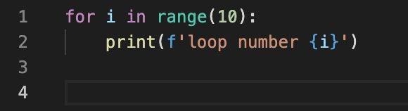
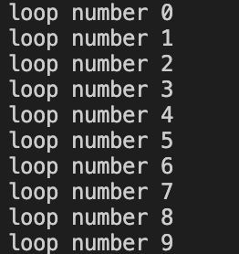
Loops: For
Output:
Notice the range function starts iteration at 0 and ends at 9 (not inclusive on stopping point)

Slide 17
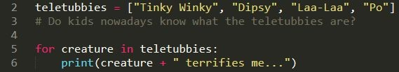
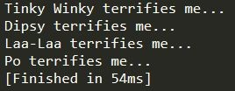
Loops: For
You can also use for loops to iterate over a list, or the characters in a string.

Slide 18
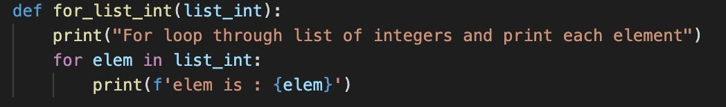
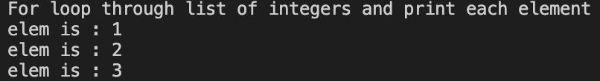
Examples of for loops
<- the function is called and a list is passed through
Output:

Slide 19
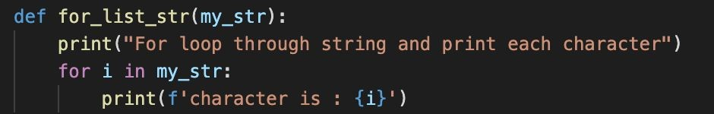
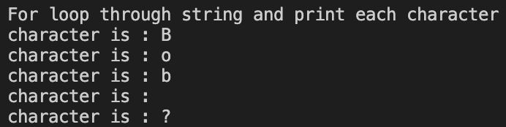
Examples of for loops
Output:

Slide 20
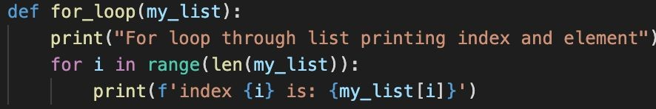

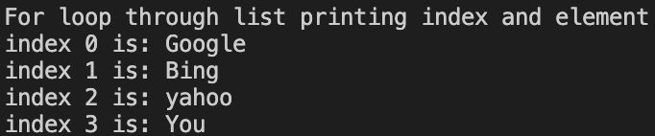
Examples of for loops
Output:

Slide 21
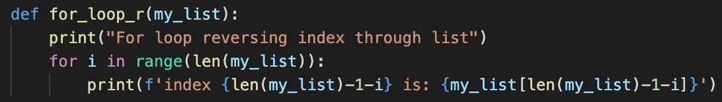

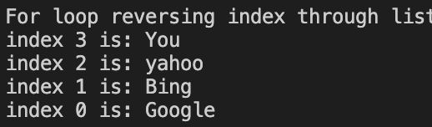
Examples of for loops
Output:

Slide 22
Loops: While
A while loop will follow a set of instructions while its boolean condition holds true.
Simply put: the computer will do x instructions until y is false.

Slide 23
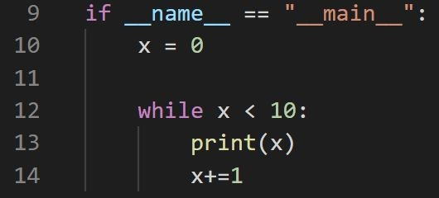

Loops: While
Output:

Slide 24
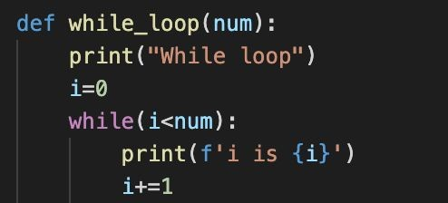
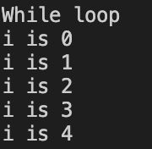
Examples of while loops
Output:

Slide 25
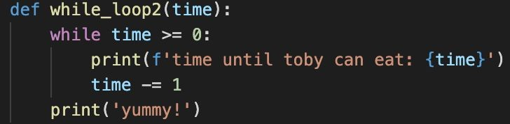
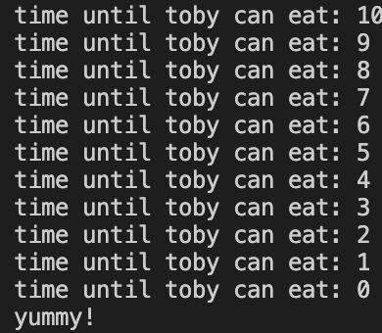

Examples of while loops
Output:

Slide 26
Loops: Nested
Nesting a loop is just a fancy way of saying putting a loop inside of another loop.
You can do this as many times as you like as long as you don’t care about your computer catching fire.

Slide 27
Loops: Nested
You can put a for loop within a for loop, a while loop within a while loop.
You can also get really spicy and put a for loop in a while loop, or a while loop in a for loop.

Slide 28
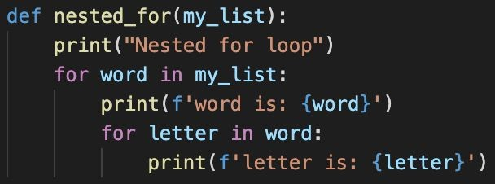
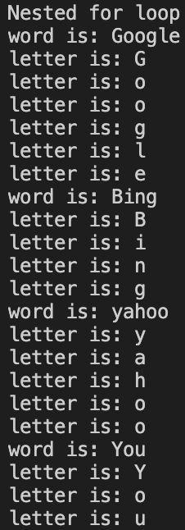

Example nested for loop
Output:

